Slide 1
ECE 571 CAN Protocol Controller Design & Verification
By
Vijay E Arputharaj
Akshay S Kotian

Slide 2
INTRODUCTION

Slide 3
CAN Bus
CAN(Controller Area Network) vehicle bus standard allows devices to communicate without host computer
Typical Automobile has around 70 ECU’s so communication requires robust but simple protocol
CAN, developed and patented by Bosch, fills this need

Slide 4
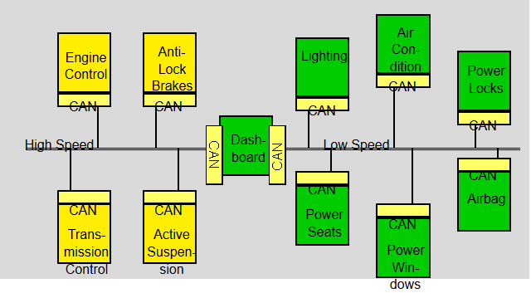
Components
CPU: Host processor decides what messages to send & receive
Controller: Protocol Implementation
- Packets, Serializes and transmits on bus
- Stores received bits and hands it over to CPU
Transceiver: Physical layer signaling

Slide 5
Features
CAN is multi-master broadcast serial standard, no limitations on number of devices
Nodes have no specific address and message identifiers are content specific
CRC check for Error Handling, NRZ bit code with stuffing for synchronization
CSMA/BA(Bitwise Arbitration), prioritized arbitration with no loss in time

Slide 6
BASIC CONCEPTS

Slide 7
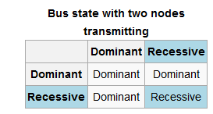
Bus Characteristics
Two Bus states
“1” = Recessive
“0” = Dominant
Bus logic is ‘Wired-AND’ i.e. Dominant bits overwrite Recessive bits

Slide 8
Bus Access and Arbitration
Arbitration is non-destructive and prioritized by message
Bitwise Arbitration scheme
Bits A[3] A[2] A[1] A[0]
Node 1
Node 2
Node 3

Slide 9
Bus Access and Arbitration
Arbitration is non-destructive and prioritized by message
Bitwise Arbitration scheme
Bits A[3] A[2] A[1] A[0]
Node 1 1
Node 2 1
Node 3 1

Slide 10
Bus Access and Arbitration
Arbitration is non-destructive and prioritized by message
Bitwise Arbitration scheme
Bits A[3] A[2] A[1] A[0]
Node 1 1 0
Node 2 1 0
Node 3 1 1

Slide 11
Bus Access and Arbitration
Arbitration is non-destructive and prioritized by message
Bitwise Arbitration scheme
Bits A[3] A[2] A[1] A[0]
Node 1 1 0 0
Node 2 1 0 1
Node 3 1 1 S

Slide 12
Bus Access and Arbitration
Arbitration is non-destructive and prioritized by message
Bitwise Arbitration scheme
Bits A[3] A[2] A[1] A[0]
Node 1 1 0 0 0 Bus Master!
Node 2 1 0 1 S
Node 3 1 1 S S

Slide 13
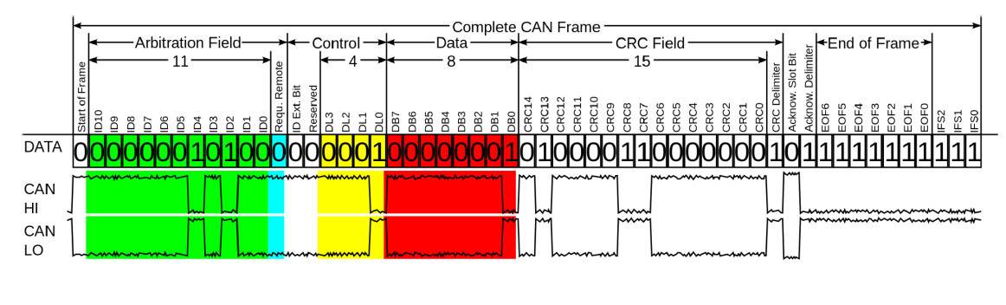
Frame Formats
Data Frame

Slide 14
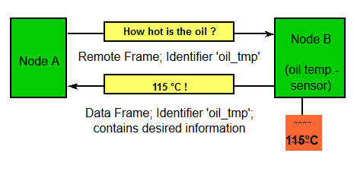
Frame Formats
Request Frame
- Similar to Data frame format but no Data field
Error Frame
- Fixed Frame format sent by all nodes on bus error

Slide 15
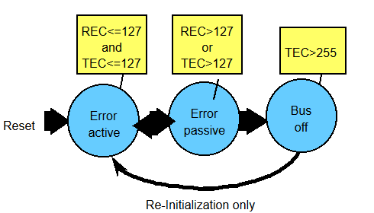
Control Flow

Slide 16
IMPLEMENTATION

Slide 17
Objective
Synthesizable Behavioral model of CAN Protocol Controller
Use System Verilog constructs for functional verification
Perform Veloce emulation in TBX mode
Studied Bosch’s CAN specification and designed from scratch , no existing code used

Slide 18
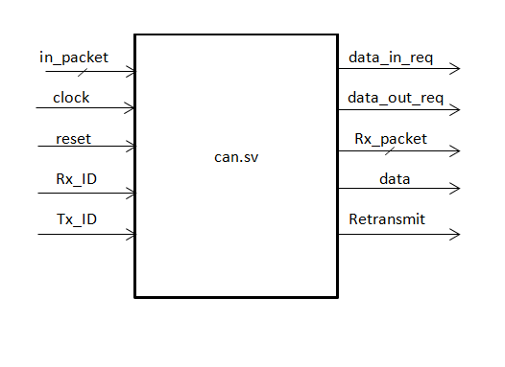
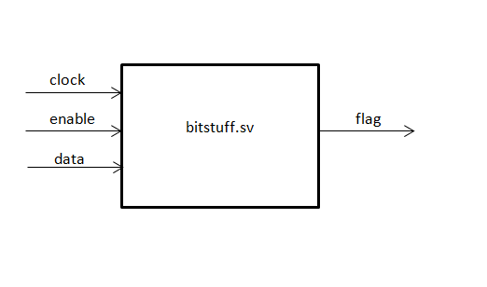
Design Blocks

Slide 19
DESIGN CONSTRUCTS

Slide 20
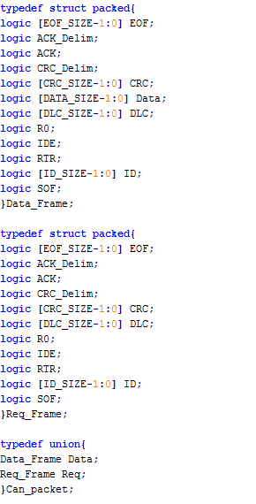
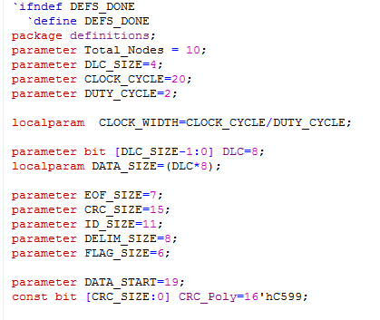
Packages
Parameters
Structures & Unions
Enums

Slide 21
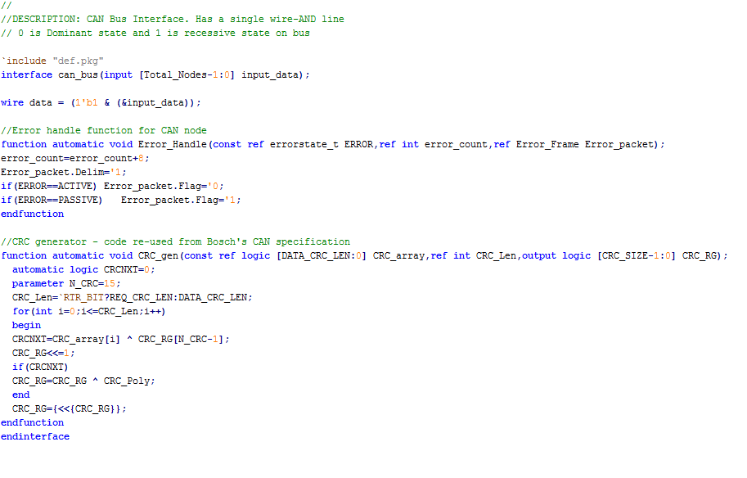
Interface

Slide 22
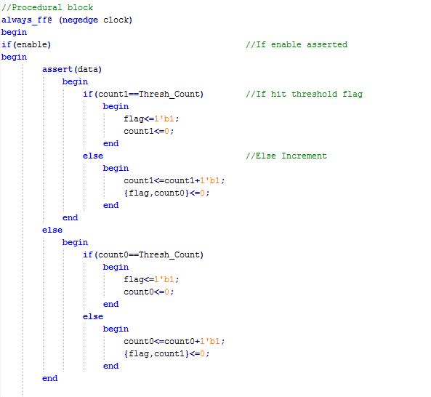
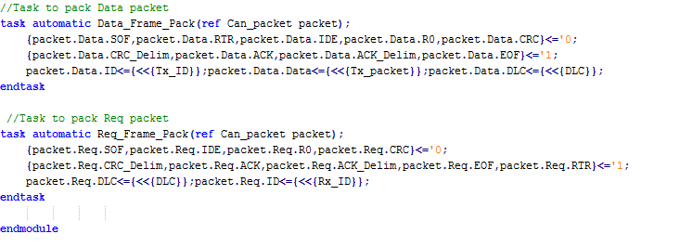
Procedural blocks
always_ff & unique
Tasks

Slide 23
Others….
.* operator
2 state & logic types
Queues & Associative arrays for debugging & Scoreboard
Foreach loops
Final blocks
timeunit & timeprecision

Slide 24
Design Features
Used generate blocks to allow multiple node instantiations
All CAN specifications such as Field widths are parameterized for code reusability
Flags for Debug, Assertion, Error inject & Veloce modes

Slide 25
VERIFICATION

Slide 26
Assertions
Employed both immediate & concurrent assertions
Helped us immensely to localize bugs at the early stages of design as each transaction took multiple cycles, looking at waveforms or $monitor output is tedious
In the later part, developed separate assertion module which runs in parallel
Ensure nodes adhered to protocol throughout simulation and also prints out a scoreboard at end

Slide 27


Immediate Assertions
IFS Check:
CRC Check:

Slide 28
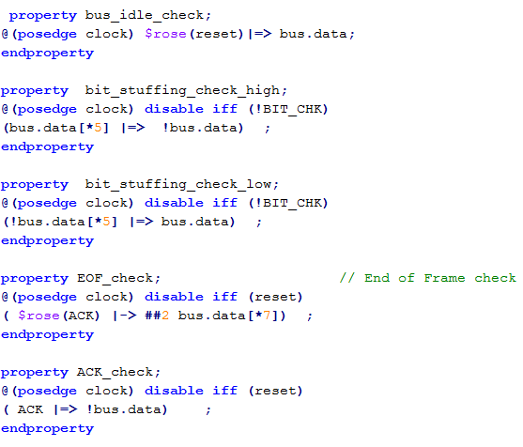
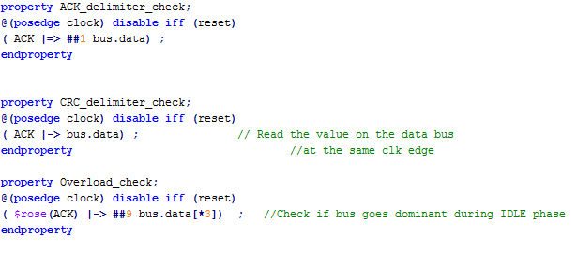
Concurrent Assertions

Slide 29
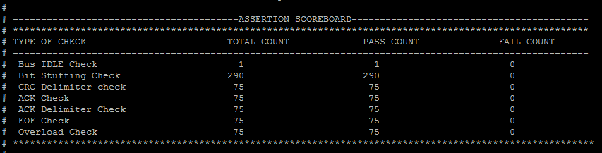
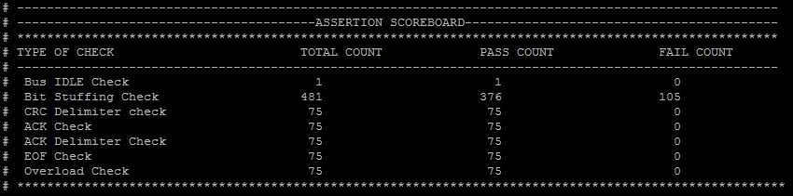
Scoreboard (Normal Mode)

Slide 30
Scoreboard (Error inject Mode)

Slide 31
VELOCE EMULATION

Slide 32
TBX Mode
XRTL Transactor configured as host processor stub for CAN nodes
Input SCEMI pipe used to get data packets generated from HVL side
Received packets, after bus transaction, are sent through output SCEMI
HVL then does scoreboard of sent and received packets and prints out log

Slide 33
HVL
Implements Constrained Randomization & OOP techniques for generating test packets & Identifiers
Monitors received packets and produces a scoreboard at end of simulation run
Logging of inputs and outputs in files

Slide 34
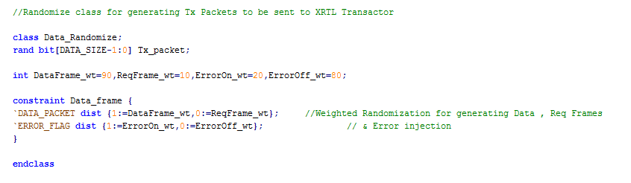
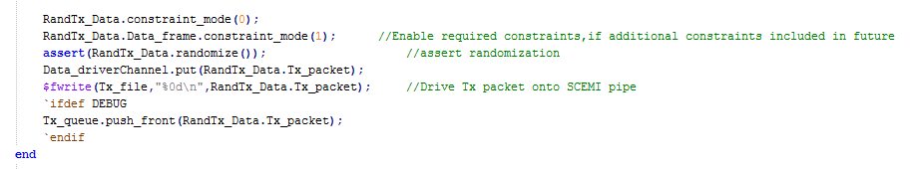
Randomization & OOP Constructs

Slide 35
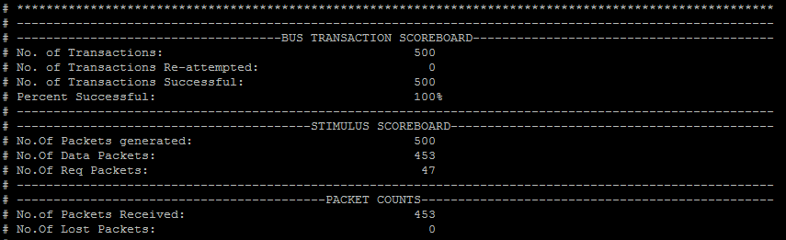
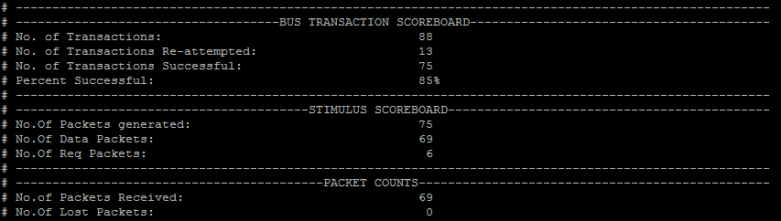
Scoreboard (Normal Mode)

Slide 36
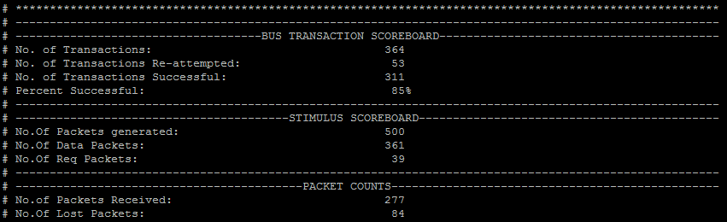
Scoreboard (Error inject Mode)

Slide 37
Verification Features
Monitor module running concurrent assertions to trap protocol violations
Weighted randomizations allows more control on test vector generation
Randomization done on:
Environment configuration – Multiple nodes instantiated using generate blocks and simple ID assignment algorithm employed by transactor to configure acceptance filters
Device configuration – Random ID’s (hence randomized priority), Error injection, type of frames

Slide 38
Summary
Build design from scratch using only a specification document
Developed test environment for generating random stimulus and scoreboard
Exercised most of the system Verilog constructs gained from the course in both design and functional verification

Slide 39
Questions ?

